Slide 1
FIN 580 HW2 Presentation
Emanuel Scoullos
Yaojun Yu

Slide 2
VAR (Vector Auto Regression)
General Methodology – VAR
Data used to fit
the first model
Data used to fit
the second model
The first
prediction
The second
prediction
T1
T1+1
T1+2
T2
T1 is the last datum in the first 3.5 years
T1+1 is the first datum in the last 1.5 years
T2 is the last datum in the test sample
First 3.5 Years
Last 1.5 Years

Slide 3
VAR (Vector Auto Regression)
We only implemented VAR on daily volatility data.
We first took log of annualized daily volatility to get log realized volatility (logRV) for model fitting and predication.
We divided the data into the first 3.5 years (until October 31st 2011) and the last 1.5 years (since November 1st 2011). The first prediction made was logRV on November 1st 2011.

Slide 4
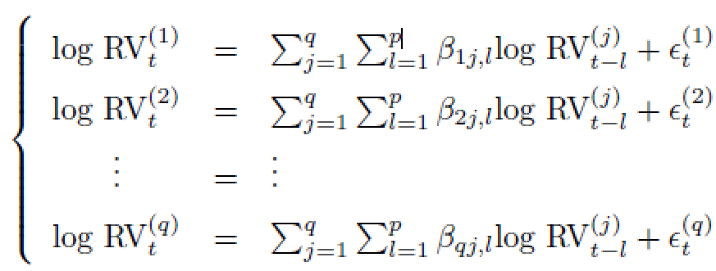
VAR (Vector Auto Regression)
Based on the q equations below, we first used p=1 to conduct linear regression analysis. Given our data, q=9.

Slide 5
VAR (Vector Auto Regression)
We used a growing window method to fit the model and make predictions. When calculating MSE and QL as well as obtaining the squared error (SE) plots, we took exponential to the both the observed and predicted logRV to calculate MSE and QL using the observed and predicted annualized volatilities for each of 9 currency pairs and obtain SE plots for each. We also calculated the average MSE and QL values to gain a better understanding about the model’s prediction performance.

Slide 6
VAR (Vector Auto Regression)
We repeated Step (5) for p=2 and p=3.
We then identified the p value that gave the best prediction performance.

Slide 7
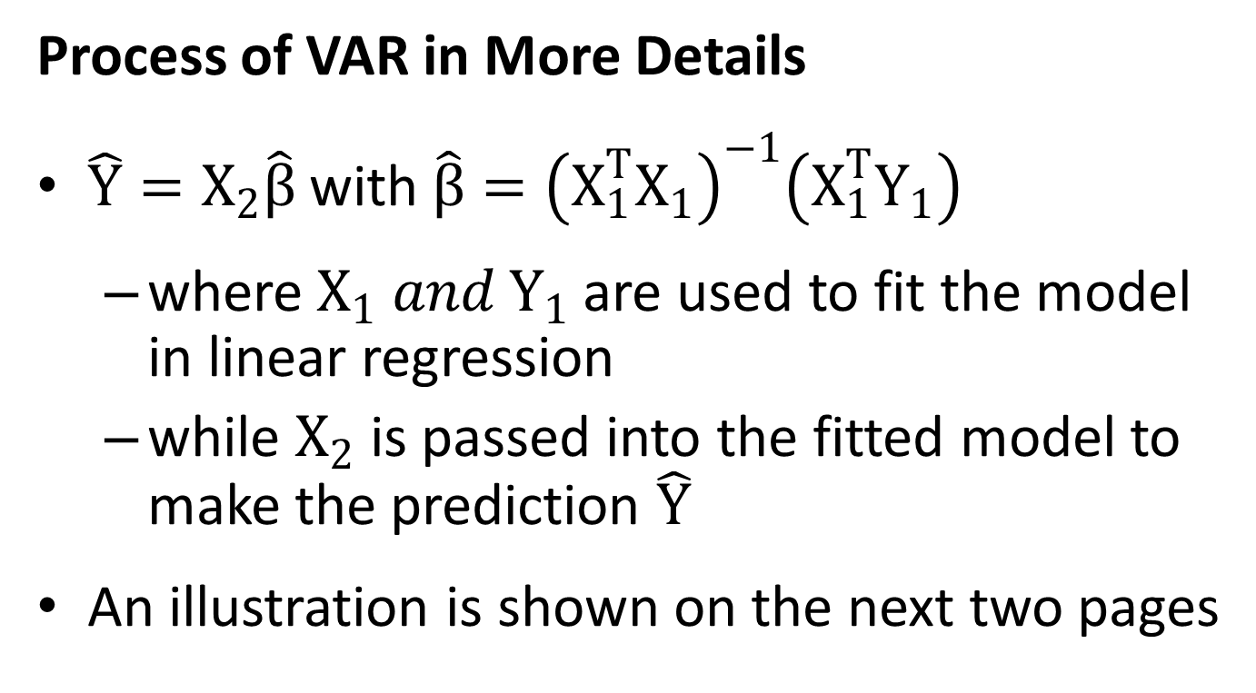
VAR (Vector Auto Regression)
Process of VAR in More Details
$\hat{Y}=X_{2}\hat{β}$with$\hat{β}={\left(X_{1}^{T}X_{1}\right)}^{−1}\left(X_{1}^{T}Y_{1}\right)$
where $X_{1} and Y_{1}$ are used to fit the model in linear regression
while $X_{2}$ is passed into the fitted model to make the prediction $\hat{Y}$
An illustration is shown on the next two pages

Slide 8
Currency Index
Time
Index
0
1
2
3
4
5
6
7
8
(0)
(1)
………………….…………………………..
(8)
t=p
Yp
logRVp
logRVp
logRVp
Data used to fit
the first model
t=p+1
Yp+1
(0)
(1)
………………….…………………………..
(8)
logRVp+1
logRVp+1
logRVp+1
Data used
to fit the
second model
…......…
…......…
…......…
…......…
…......…
…......…
…......…
Y
=
=
(0)
(1)
………………….…………………………..
(8)
t=T1
YT1
logRVT1
logRVT1
logRVT1
YT1+1
(0)
(1)
………………….…………………………..
(8)
Data used
to fit the
last model
t=T1+1
logRVT1+1
logRVT1+1
logRVT1+1
t=T1+2
YT1+2
(0)
(1)
………………….…………………………..
(8)
logRVT1+2
logRVT1+2
…...
…...
…...
logRVT1+2
…...
…...
…...
…...
t=T2-1
YT2-1
(0)
(1)
………………….…………………………..
(8)
logRVT2-1
logRVT2-1
logRVT2-1
YT2
(0)
(1)
………………….…………………………..
(8)
t=T2
logRVT2
logRVT2
logRVT2
The prediction
made by
the last
fitted model
The prediction
made by
the first
fitted model
The prediction made by
the second
fitted model

Slide 9
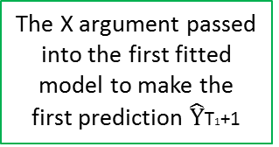
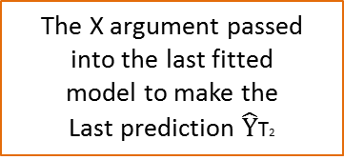
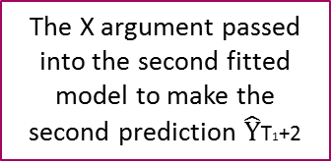
Currency Index
0
…………………………………..….………..
8
Time
Index
(0)
…
(0)
………………….………..
(8)
…
(0)
t=p
Xp-1
logRVp-1
logRV0
logRVp
logRV0
Data used to fit
the first model
(0)
(0)
………………….………..
(8)
(0)
t=p+1
Xp
logRVp+1
…
logRV1
logRVp+1
…
logRV1
…......…
…......…
…......…
Data used
to fit the
second model
…......…
…......…
…......…
…......…
X
=
=
(0)
…
(0)
………………….………..
(8)
…
(0)
t=T1
XT1-1
logRVT1-1
logRVT1-p
logRVT1
logRVT1-p
XT1
(0)
…
(0)
………………….………..
(8)
…
(0)
Data used
to fit the
last model
t=T1+1
logRVT1
logRVT1-p+1
logRVT1+1
logRVT1-p+1
t=T1+2
XT1+1
(0)
…
(0)
………………….………..
(8)
…
(0)
logRVT1+1
logRVT1-p+2
logRVT1+2
logRVT1-p+2
…...
…...
…...
…...
…...
…...
…...
(0)
…
(0)
………………….………..
(8)
…
(0)
t=T2-1
XT2-2
logRVT2-1
logRVT2-1
logRVT2-1
logRVT2-1
(0)
…
(0)
………………….………..
(8)
…
(0)
t=T2
XT2-1
logRVT2
logRVT2
logRVT2
logRVT2
The X argument passed into the first fitted
model to make the
first prediction $\hat{Y}$T1+1
The X argument passed into the second fitted
model to make the
second prediction $\hat{Y}$T1+2
The X argument passed into the last fitted
model to make the
Last prediction $\hat{Y}$T2

Slide 10
LASSO / Ordered LASSO
General Methodology
Lasso is a shrinkage and selection method for linear regression. It minimizes the usual sum of squared errors, with a bound on the sum of the absolute values of the coefficients.
Ordered Lasso fits a linear model and imposes an order constraint on the coefficients. It writes the coefficients as positive and negative parts, and requires positive parts and negative parts are non-increasing and positive.

Slide 11
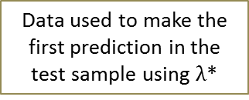

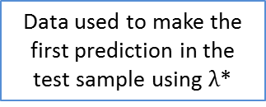

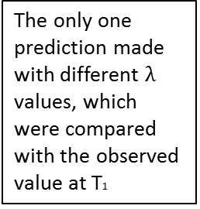
For LASSO / Ordered LASSO without Cross Validation
The only one prediction made with different $λ$ values, which were compared with the observed value at T1
Data used to fit the model using $λ_{1}$ in the training sample
The first prediction
made in the
test sample
Data used to fit the model using $λ_{2}$ in the training sample
…
Data used to fit the model using $λ_{n}$ in the training sample
The second prediction
made in the
test sample
…
T1-1
T1
T1+1
T1+2
T2
Data used to make the
first prediction in the
test sample using $λ$*
Data used to make the
first prediction in the
test sample using $λ$*
Training Sample
(first 3.5 years)
Test Sample
(last 1.5 years)
Pick the optimal $λ$*
Test using the optimal $λ$*
T₁ is the last datum in the training sample
T₁+1 is the first datum in the test sample

Slide 12
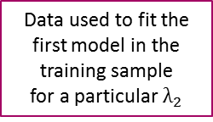
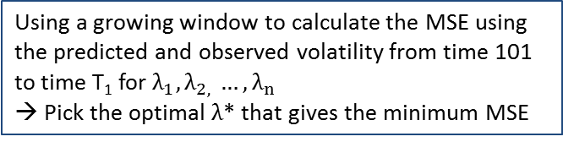
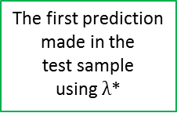
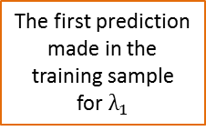
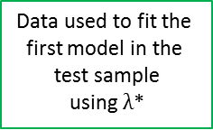
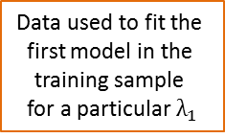

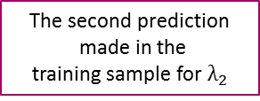
For LASSO / Ordered LASSO with Cross Validation
Data used to fit the
first model in the
training sample
for a particular $λ_{1}$
The first prediction
made in the
training sample
for$λ_{1}$
Data used to fit the
first model in the
test sample
using $λ$*
The first prediction
made in the
test sample
using $λ$*
Data used to fit the
first model in the
training sample
for a particular $λ_{2}$
The second prediction
made in the
training sample for$λ_{2}$
100
101
102
T1
T1+1
T2
T₁ is the last datum in the training sample
T₁+1 is the first datum in the test sample
Skip the first 100 data
Training Sample
(first 3.5 years)
Test Sample
(last 1.5 years)
Using a growing window to calculate the MSE using the predicted and observed volatility from time 101 to time T₁ for $λ_{1},λ_{2, }…,λ_{n}$
→ Pick the optimal $λ$* that gives the minimum MSE
Test using the optimal $λ$*

Slide 13
LASSO/Ordered LASSO
General Methodology - LASSO/Ordered LASSO
We only implemented LASSO/Ordered LASSO on daily volatility data.
We used logRV for model fitting and predication as we did in VAR.
We divided the data into the training sample (first 3.5 years until October 31st 2011) and the test sample (last 1.5 years since November 1st 2011).

Slide 14
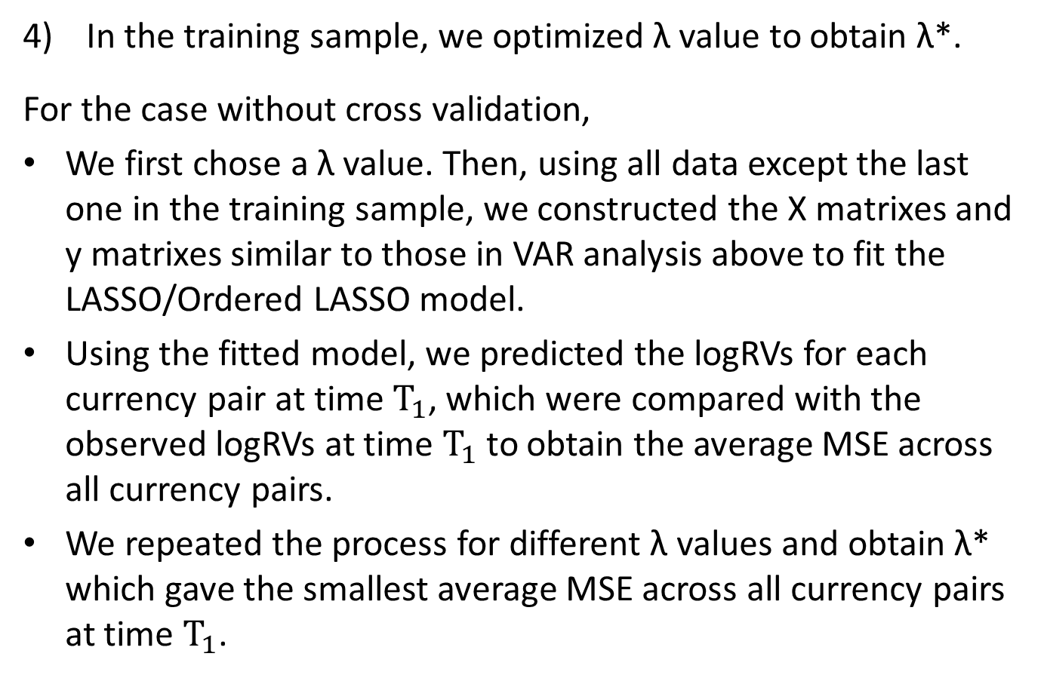
LASSO/Ordered LASSO
In the training sample, we optimized λ value to obtain λ*.
For the case without cross validation,
We first chose a λ value. Then, using all data except the last one in the training sample, we constructed the X matrixes and y matrixes similar to those in VAR analysis above to fit the LASSO/Ordered LASSO model.
Using the fitted model, we predicted the logRVs for each currency pair at time $T_{1}$, which were compared with the observed logRVs at time $T_{1}$ to obtain the average MSE across all currency pairs.
We repeated the process for different λ values and obtain λ* which gave the smallest average MSE across all currency pairs at time $T_{1}$.

Slide 15
LASSO/Ordered LASSO
In the training sample, we optimized λ value to obtain λ*.
For the case with cross validation,
We first chose a λ value. Then, using the first 100 logRVs in the training sample, we constructed the X matrixes and y matrixes similar to those in VAR analysis above to fit the LASSO/Ordered LASSO model. Using the fitted model, we predicted the 101th logRV for each currency pair at time 101.
Then, using the same λ value and the first 101 logRVs in the training sample, we constructed the X matrixes and y matrixes similar to those in VAR analysis above to fit the LASSO/Ordered LASSO model. Using the fitted model, we predicted the 102th logRV for each currency pair at at time 102.

Slide 16
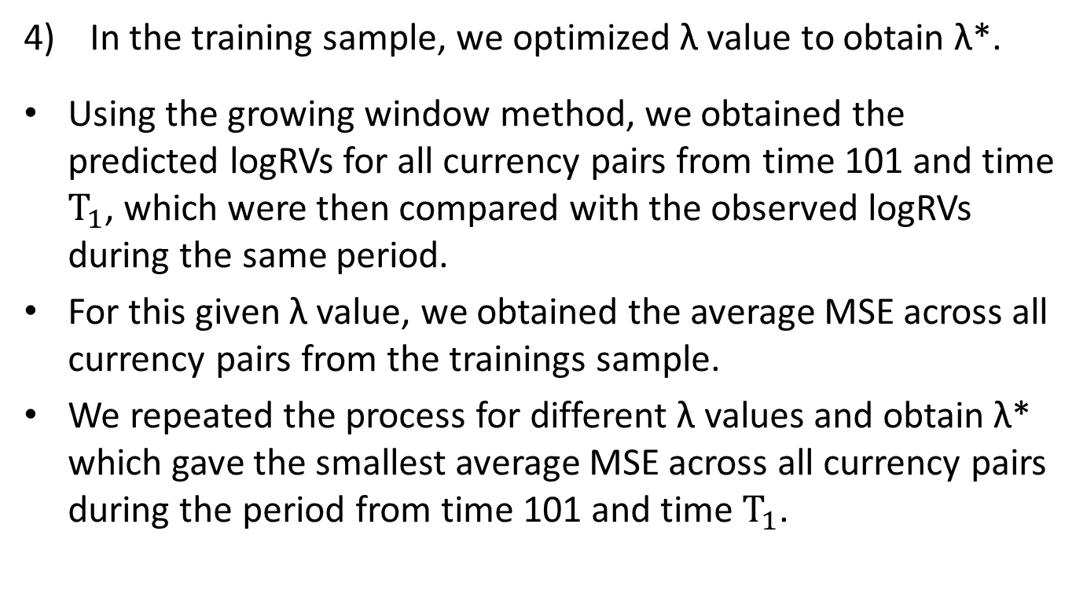
LASSO/Ordered LASSO
In the training sample, we optimized λ value to obtain λ*.
Using the growing window method, we obtained the predicted logRVs for all currency pairs from time 101 and time $T_{1}$, which were then compared with the observed logRVs during the same period.
For this given λ value, we obtained the average MSE across all currency pairs from the trainings sample.
We repeated the process for different λ values and obtain λ* which gave the smallest average MSE across all currency pairs during the period from time 101 and time $T_{1}$.

Slide 17
LASSO/Ordered LASSO
We then used the LASSO/Ordered LASSO model with the optimal λ* we obtained from the training sample on the test sample to obtain MSE and QL as well as the SE plot, adopting the growing window method.

Slide 18
LASSO/Ordered LASSO
The LASSO was implemented using the penalized package in R.
The Ordered LASSO was implemented in R using orderedLasso package.
In both LASSO and Ordered LASSO, we utilized all columns of X matrix and each column of Y matrix in VAR as the model inputs to obtain fitted parameters.

Slide 19
KNN
General Methodology - KNN Regression
Data used to fit the
first model in the
training sample
The first prediction
made in the
training sample
Data used to fit the
first model in the
test sample
The first prediction
made in the
test sample
100
101
T1
T1+1
T2
T₁ is the last datum in the training sample
T₁+1 is the first datum in the test sample
Skip the first 100 data
Training Sample
(first 3.5 years)
Test Sample
(last 1.5 years)
Pick the optimal k*
Test using the optimal k*

Slide 20
KNN
We divided the data into the training sample (first 3.5 years until October 31st 2011) and the test sample (last 1.5 years since November 1st 2011).
We used an expanding window (i.e., using all historical data) to find the k-nearest points.
Notice that since we applied KNN on a time series of annualized daily volatilities, we should not use the random sampling method which ignores the time information.

Slide 21
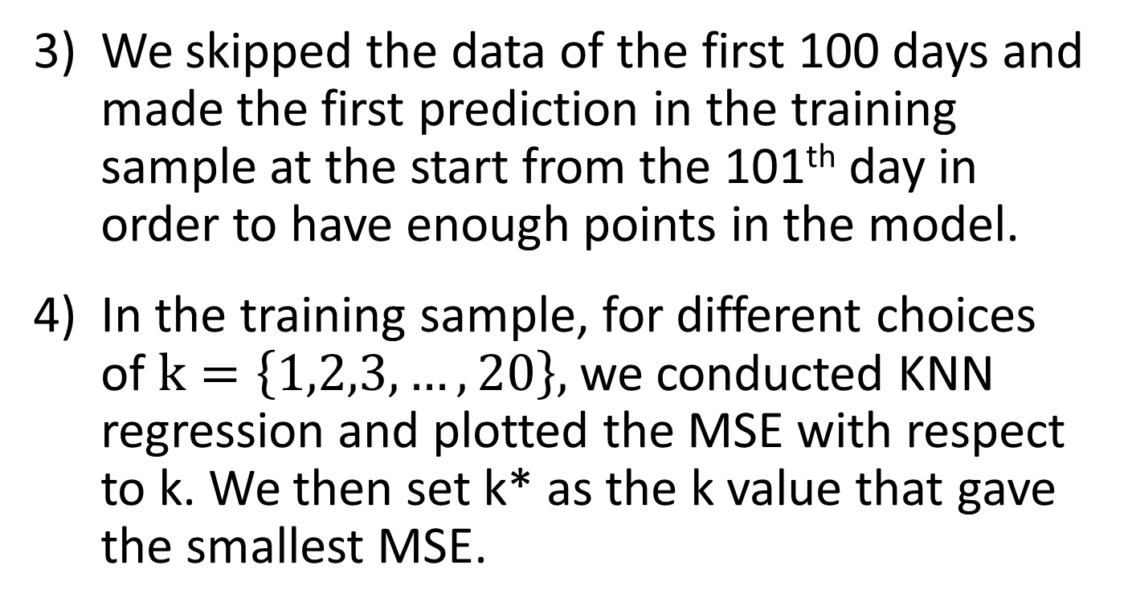
KNN
We skipped the data of the first 100 days and made the first prediction in the training sample at the start from the 101th day in order to have enough points in the model.
In the training sample, for different choices of $k=\left\{1,2,3,…,20\right\},$we conducted KNN regression and plotted the MSE with respect to k. We then set k* as the k value that gave the smallest MSE.

Slide 22
KNN
In the test sample, we used k* to conduct KNN regression, and measured prediction performance using MSE, QL and SE plot.

Slide 23
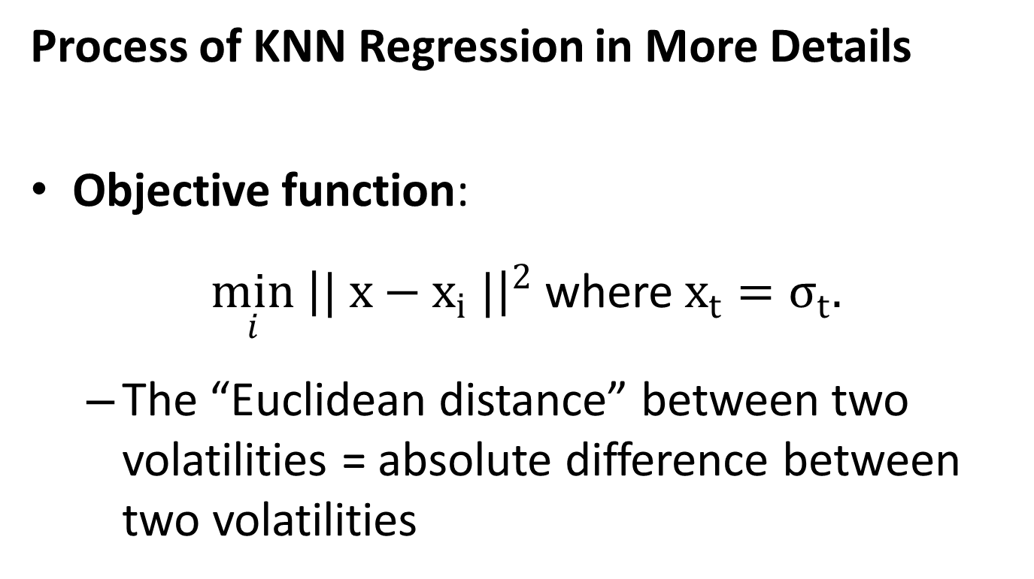
KNN
Process of KNN Regression in More Details
Objective function:
$\min_{i} {\left|| x−x_{i} |\right|}^{2}$ where $x_{t}=σ_{t}.$
The “Euclidean distance” between two volatilities = absolute difference between two volatilities

Slide 24

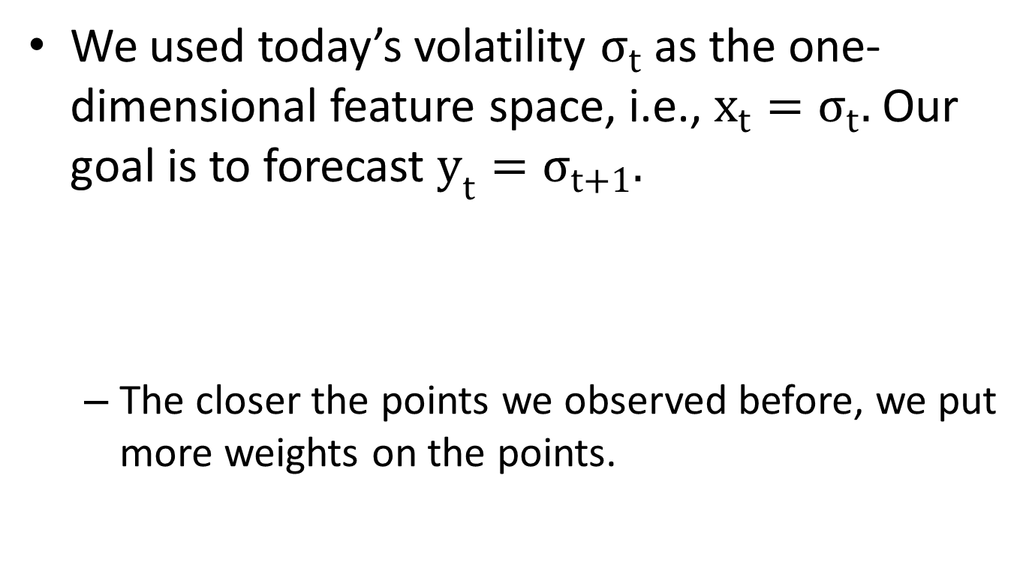
KNN
We used today’s volatility $σ_{t}$ as the one-dimensional feature space, i.e., $x_{t}=σ_{t}.$ Our goal is to forecast $y_{t}=σ_{t+1}.$
The closer the points we observed before, we put more weights on the points.

Slide 25
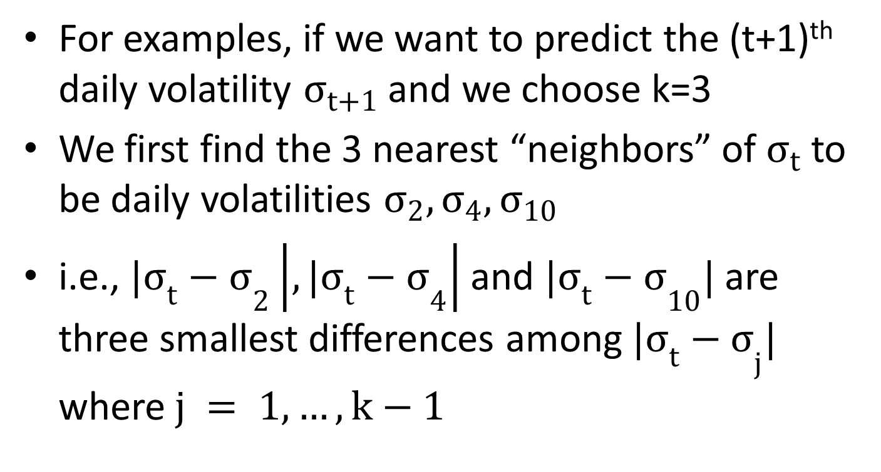
KNN
For examples, if we want to predict the (t+1)^{th} daily volatility $σ_{t+1}$ and we choose k=3
We first find the 3 nearest “neighbors” of $σ_{t}$to be daily volatilities $σ_{2},σ_{4},σ_{10}$
i.e., ${{|σ}_{t}−σ}_{2}\left|,{{|σ}_{t}−σ}_{4}\right|$ and ${{|σ}_{t}−σ}_{10}|$ are three smallest differences among ${{|σ}_{t}−σ}_{j}|$ where$j = 1, …, k−1$

Slide 26

KNN
Then we have
$$\hat{σ_{t+1}}= {f( σ}_{3},σ_{5},σ_{11})=α_{1}σ_{3}+α_{2}σ_{5}+α_{3}σ_{11}$$
where $α_{1}=\frac{c}{{\left(σ_{t}−σ_{2}\right)}^{2}} ,$
$$α_{2}=\frac{c}{{\left(σ_{t}−σ_{4}\right)}^{2}},$$
$$α_{3}=\frac{c}{{\left(σ_{t}−σ_{10}\right)}^{2}}and$$
$\sum{α_{j}=1}$

Slide 27
KNN – Including Time Element
Using rolling window, i.e., the fixed look-back window, when training the model. We used 100 as the rolling window size.
In the training sample, we first chose a k value and then conducted KNN regression using the fixed look-back window.
We tried different values of k and set the optimal k* as the one that gives the smallest MSE in the training sample.
In the test sample, we used k* as the optimal look-back window to conduct KNN regression, and measured prediction performance using MSE, QL and SE plot.

Slide 28
Results Summary

Slide 29
Results Summary VAR

Slide 31
Results Summary LASSO/Ordered LASSO with Cross Validation
Currency Pairs: AUDUSD, CADUSD, CHFUSD, EURUSD, GBPUSD, NOKUSD and NZDUSD
LASSO: p=1, 2 and 3
Ordered LASSO: p=1, 2, 3 and 5

Slide 32
LASSO/Ordered LASSO with Cross Validation Outputs in the Test Sample
Background colors:
Yellow: LASSO & Ordered LASSO with Cross Validation with p=1
Blue: LASSO & Ordered LASSO with Cross Validation with p=2
Pink: LASSO & Ordered LASSO with Cross Validation with p=3
Green: LASSO & Ordered LASSO with Cross Validation with p=5
Text colors:
Purple: LASSO with Cross Validation
Orange: Ordered LASSO with Cross Validation

Slide 33
LASSO/Ordered LASSO with Cross Validation Outputs in the Test Sample
Key Observations:
Ordered LASSO with cross validation generally performs better than LASSO with cross validation according to the rank of sum of MSE and that of sum of QL
Ordered LASSO generally outperforms LASSO when lag p=1, 2 and 3
The prediction performance of Ordered LASSO with cross validation with different lags is ranked as:
Ordered LASSO with p=1 ≻ Ordered LASSO with p=5
≻ Ordered LASSO with p=3 ≻ Ordered LASSO with p=2
The prediction performance of LASSO with cross validation with different lags is ranked as:
LASSO with p=1 ≻ LASSO with p=2 ≻ LASSO with p=3

Slide 34
LASSO with Cross Validation
Currency Pairs: AUDUSD, CADUSD, CHFUSD, EURUSD, GBPUSD, NOKUSD and NZDUSD
(p=1, 2 and 3)

Slide 35
LASSO with Cross Validation Optimal Lambda Values
Please Click Here to Get the Plots of MSE against log(lambda) for LASSO with Cross Validation (p=1,2 and 3)

Slide 36
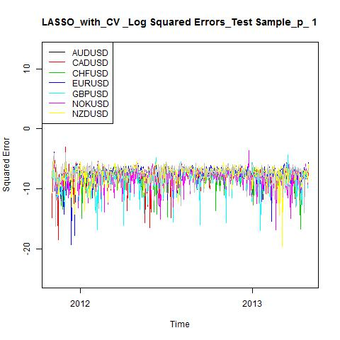

Slide 37
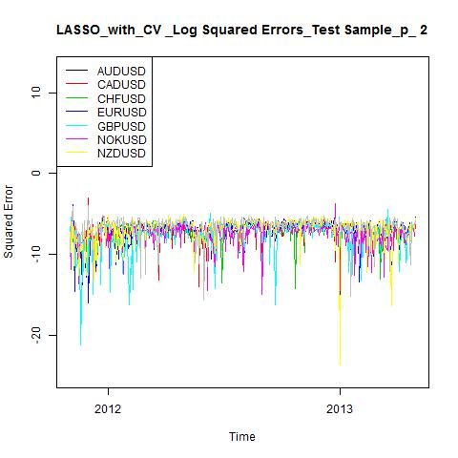

Slide 38


Slide 39
Ordered LASSO with Cross Validation
Currency Pairs: AUDUSD, CADUSD, CHFUSD, EURUSD, GBPUSD, NOKUSD and NZDUSD
(p=1, 2, 3 and 5)

Slide 40
Ordered LASSO with Cross Validation Optimal Lambda Values
Please Click Here to Get the Plots of MSE against log(lambda) for Ordered LASSO with Cross Validation (p=1,2, 3 and 5)

Slide 41
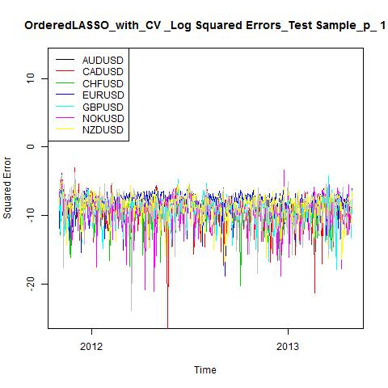

Slide 42
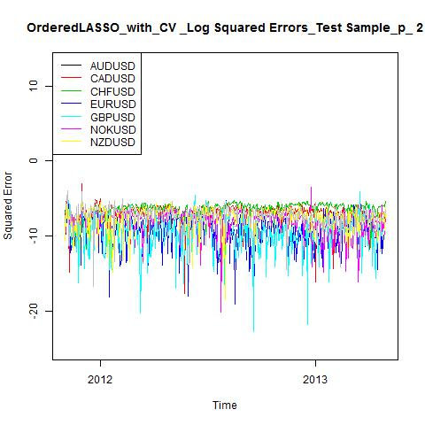

Slide 43
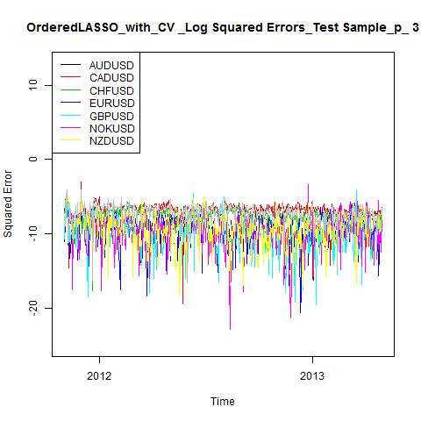

Slide 44
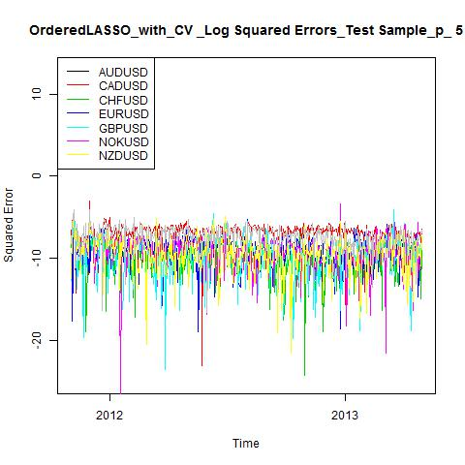

Slide 45
Results Summary LASSO/Ordered LASSO without Cross Validation
Currency Pairs: AUDUSD, CADUSD, CHFUSD, EURUSD, GBPUSD, NOKUSD and NZDUSD
LASSO: p=1, 2 and 3
Ordered LASSO: p=1, 2, 3 and 5

Slide 46
LASSO/Ordered LASSO without Cross Validation Outputs in the Test Sample
Background colors:
Yellow: LASSO & Ordered LASSO with Cross Validation with p=1
Blue: LASSO & Ordered LASSO with Cross Validation with p=2
Pink: LASSO & Ordered LASSO with Cross Validation with p=3
Green: LASSO & Ordered LASSO with Cross Validation with p=5
Text colors:
Purple: LASSO with Cross Validation
Orange: Ordered LASSO with Cross Validation

Slide 47
LASSO/Ordered LASSO without Cross Validation Outputs in the Test Sample
Key Observations:
LASSO with lag p=1 has the best prediction performance according to the rank of sum of MSE and that of sum of QL
Ordered LASSO without cross validation generally performs better than LASSO without cross validation
Ordered LASSO generally outperforms LASSO when lag p=2 and 3
Ordered LASSO underperforms LASSO when lag p =5
The prediction performance of Ordered LASSO without cross validation with different lags is ranked as (the same as the rank when cross validation is conducted):
Ordered LASSO with p=1 ≻ Ordered LASSO with p=5
≻ Ordered LASSO with p=3 ≻ Ordered LASSO with p=2
The prediction performance of LASSO with cross validation with different lags is ranked as(the same as the rank when cross validation is conducted):
LASSO with p=1 ≻ LASSO with p=2 ≻ LASSO with p=3

Slide 48
LASSO without Cross Validation
Currency Pairs: AUDUSD, CADUSD, CHFUSD, EURUSD, GBPUSD, NOKUSD and NZDUSD
(p=1, 2 and 3)

Slide 49
LASSO without Cross Validation Optimal Lambda Values
Please Click Here to Get the Plots of MSE against log(lambda) for LASSO (p=1,2 and 3)

Slide 50
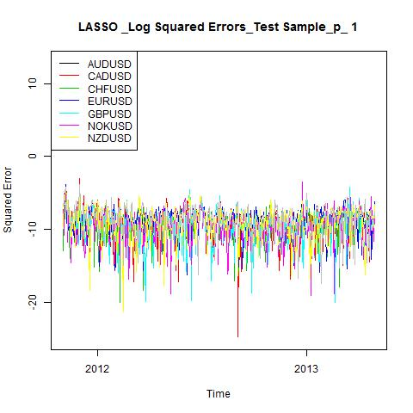

Slide 51
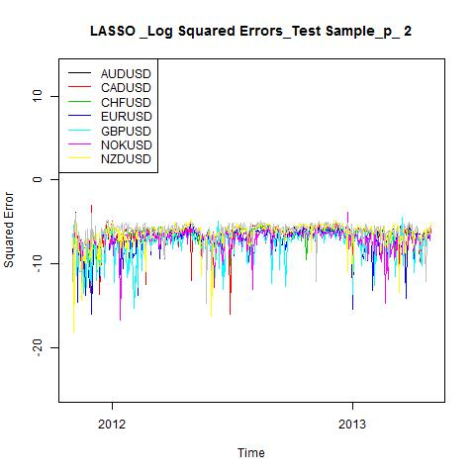

Slide 52
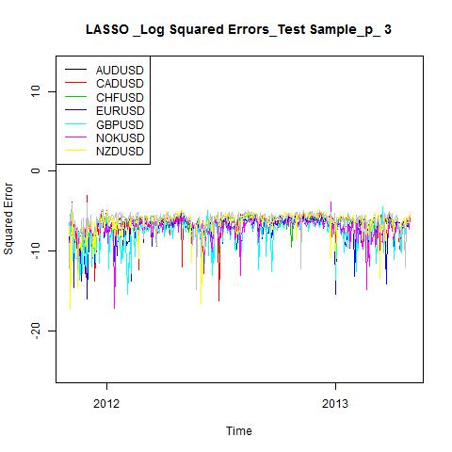

Slide 53
Ordered LASSO without Cross Validation
Currency Pairs: AUDUSD, CADUSD, CHFUSD, EURUSD, GBPUSD, NOKUSD and NZDUSD
(p=1, 2, 3 and 5)

Slide 54
Ordered LASSO without Cross Validation Optimal Lambda Values
Please Click Here to Get the Plots of MSE against log(lambda) for Ordered LASSO (p=1,2, 3 and 5)

Slide 55
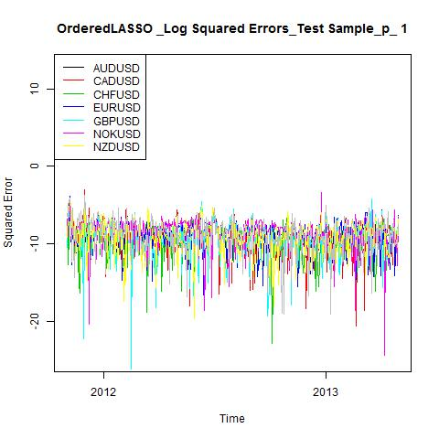

Slide 56
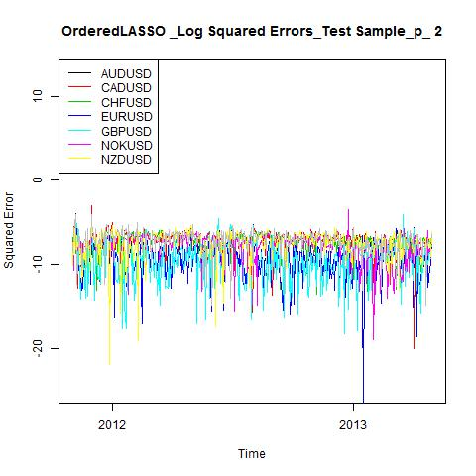

Slide 57
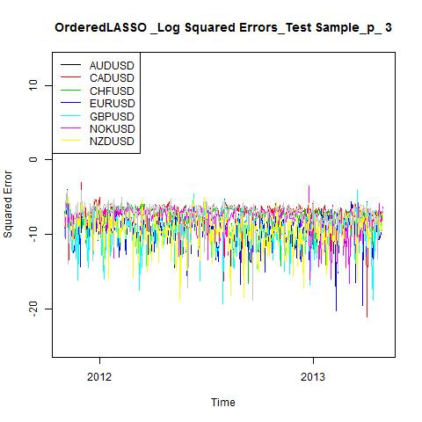

Slide 58
